Slide 1

ALZHEIMER’S DATA ANALYSIS

Slide 2
Introduction
A loss of memory or other mental abilities that is severe enough to interfere with daily life is considered to as dementia.
Caused by physical changes in the brain
Alzheimer is the most common type of dementia that causes problems with memory, thinking and behavior.
Symptoms develop slowly and get worse over time, may become severe enough to interfere with daily tasks

Slide 3
Introduction cont..
Age is the greatest known risk factor for dementia while it is not just a disease of old age.
Approximately 200,000 Americans have early on set Alzheimer’s disease.
It is the 6th leading cause of death in the US
Alzheimer’s has no cure but can be treated with symptoms and the research is still being continued.

Slide 4
MOTIVE of data analysis on Alzheimer’s disease
Since there is no cure for Alzheimer’s if we detect it in an early stage , it can be treated.
Our main aim is to detect whether the patient has Alzheimer’s based on the data we collected and using machine learning algorithms to predict and analyze this disease.

Slide 5
DATA SOURCE
The data source from this project is acquired from Open Access Series of Imaging Studies (OASIS) of neurology.
This dataset consists of a longitudinal collection MRI data of 150 persons aged from 60 to 96.
Each person was scanned on 2 or more visits.
The persons are all right-handed and include both men and women.
72 persons are non demented whereas 64 are demented at the time of their initial visit.
14 were non demented at initial visit and characterized as demented at a later visit.

Slide 6
Description of dataset
we will be using longitudinal MRI data which consists to subjects aged 60 to 96
Everyone is right-handed
Each subject is scanned at least once
The subjects who were reported as non demented were marked as converted who were characterized as demented later.

Slide 7
DATA set Description contd..
COL Description
EDUC Years of Education
SES Socioeconomic Status
MMSE Mini Mental State Examination (range is from 0 = worst to 30 = best)
CDR Clinical Dementia Rating (0 = no dementia, 0.5 = very mild AD, 1 = mild AD, 2 = moderate AD)
eTIV Estimated Total Intracranial Volume, mm3
nWBV Normalize Whole Brain Volume (atlas-masked image that are labeled as gray or white matter by the automated tissue segmentation process)
ASF Atlas Scaling Factor (Computed scaling factor that transforms native-space brain and skull to the atlas target (i.e., the determinant of the transform matrix))

Slide 8
Technologies and libraries
The jupyter platform with python libraries was used for the setup
The libraries used are:
Pandas
Seaborn
Sklearn
NumPy

Slide 9

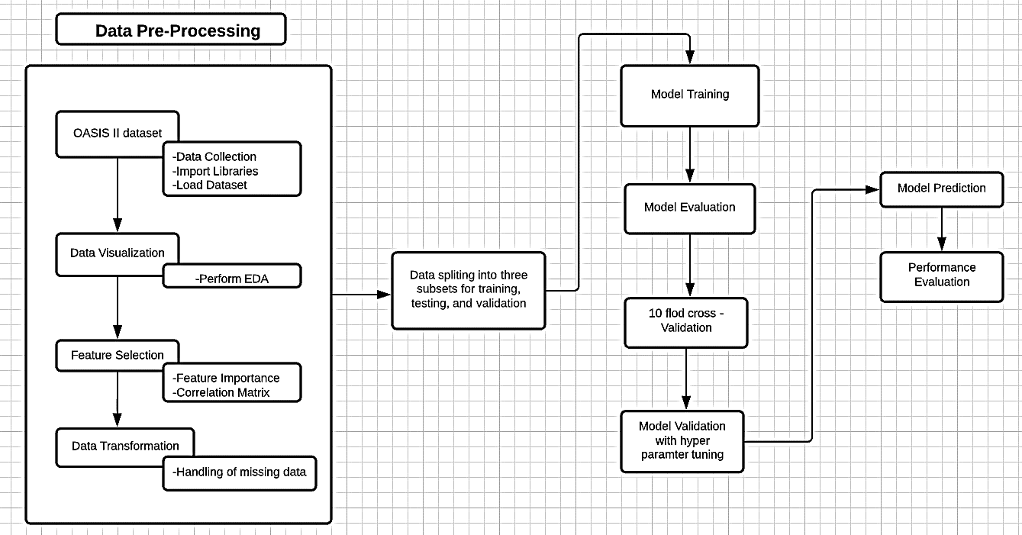
PHASES

Slide 10
PHASES
Data Pre-processing:
In the data pre-processing phase OASIS longitudinal MRI data set is collected and loaded and necessary libraries are imported.
Data Visualization:
In this phase, we perform exploratory data analysis that incorporates different methods and tools to advance the statistical insight and data representation.

Slide 11
PHASES CONTD…
Feature selection:
The identification of a relationship between different MRI features helps in the detection of highly correlated features with the target group. To do that correlation, a matrix was developed to understand the relationship among given features and targeted outcomes.
The outcome of the correlation matrix heatmap can be visualized as shown in figure in the next slide

Slide 12
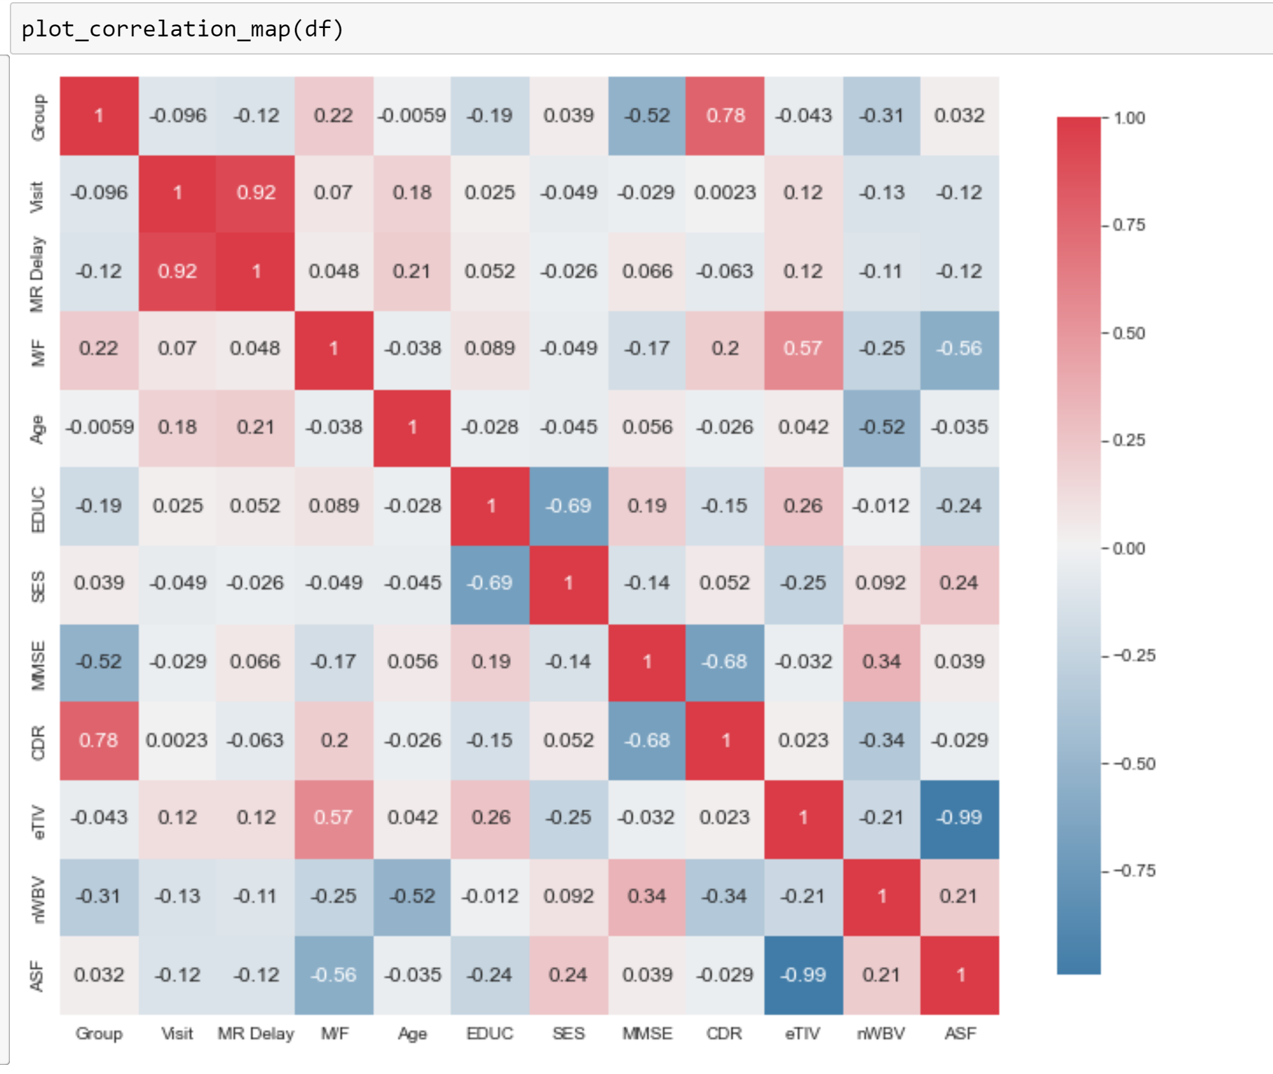
Co-relation
Correlation is used to summarize the strength and direction of the linear association between two quantitative variables. It is denoted by r and values between -1 and +1. A positive value for r indicates a positive association, and a negative value for r indicates a negative association.

Slide 13
PHASES contd..
Data Transformation:
Real world data consists of missing values and noise and it is raw data which cannot be directly involved in developing ML models.
To transform the noisy data into a clean data some data cleaning and data formatting steps are needed.
Data Splitting:
In this, we divide the dataset into 3 subsets for cross validation where one is used as test data and the other two are used as training and validation data.
The whole data is split in the ratio of 80:20 where 80% is used as training data and 20% as test data.

Slide 14
PHASES CONTD..
After model training, the training data is split into 2 subsets for training and validation.
After training the models along with validation, 10-fold cross validation will be performed

Slide 15
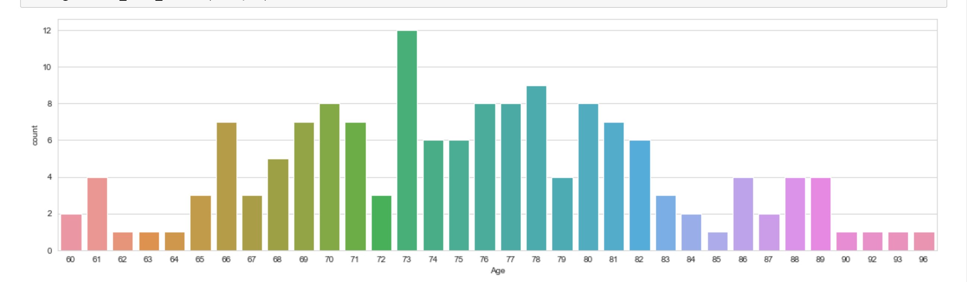
Age vs DEmENTED
THE data we collected is from age group of 60-90 among them
73 AGE group age group is more prone to Alzheimer’s than other age group
Age group in 62-64 are far less exhibiting these symptoms

Slide 16

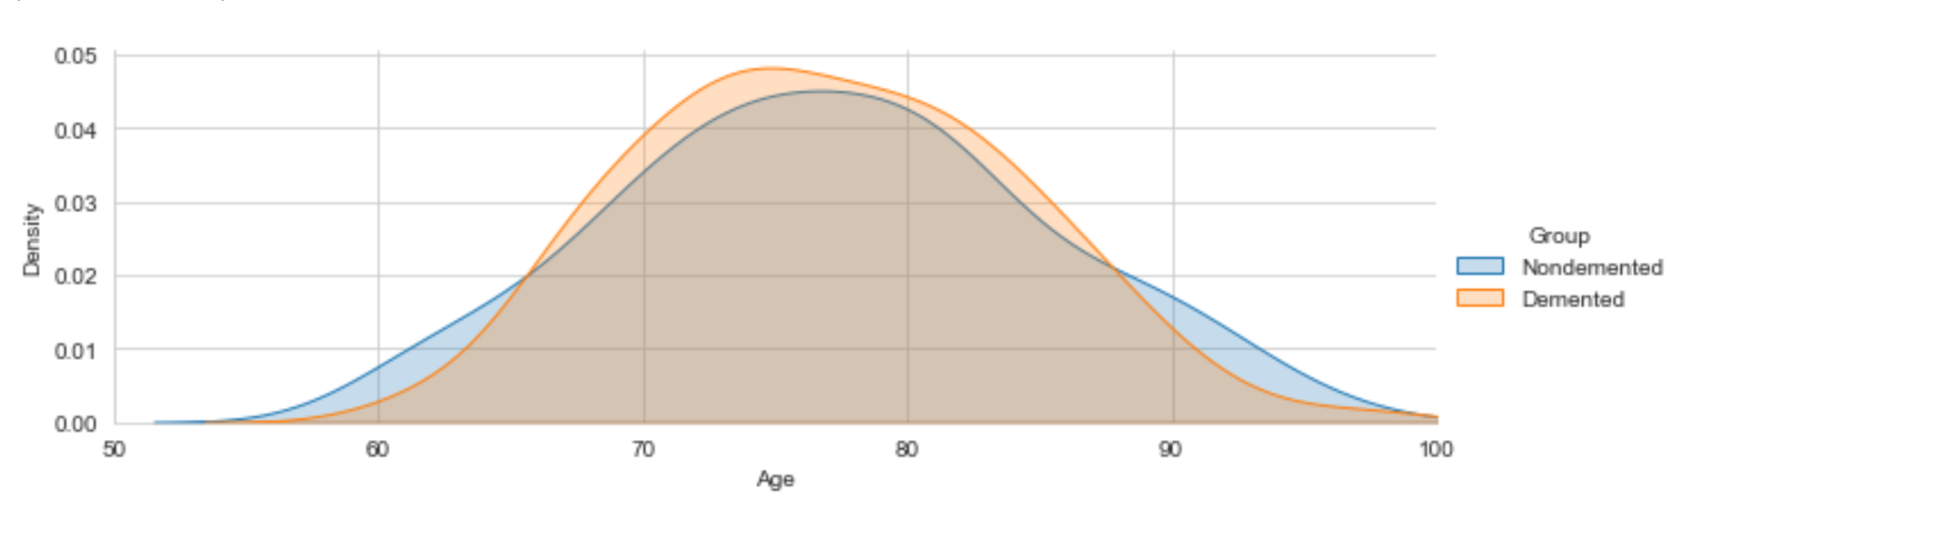

Slide 17
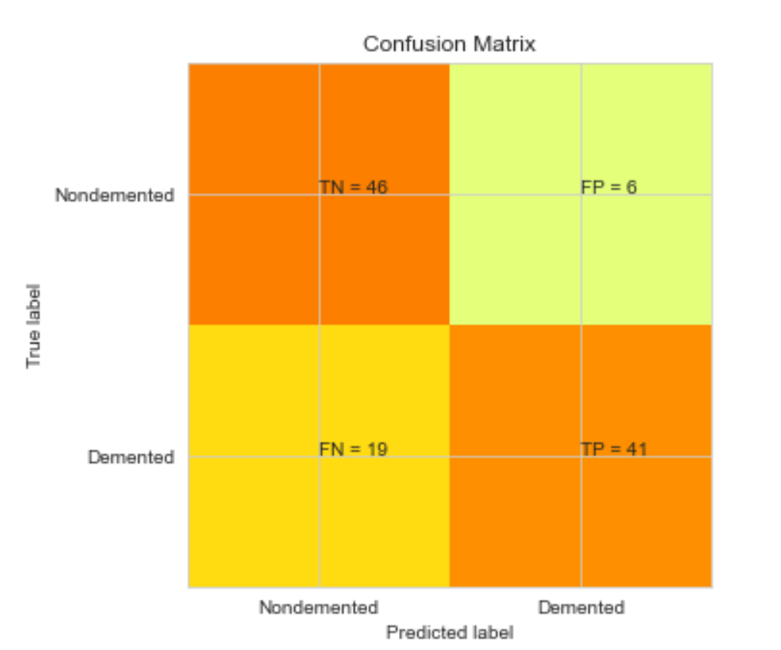
Confusion MATRIX OF DEMENTED SUBJECTS
The confusion matrix of the Support Vector Machine Algorithm (SVM) is as shown

Slide 18

Thank YOU

